Slide 1
Recommendation System using NCF and MF
Student ID: 521030990007
EMIL HARUTYUNYAN

Slide 2
01 Introduction
02 Literature Review
Contents
03 Methodology
04 Results

Slide 3
01 Introduction
‹#›

Slide 4
Introduction
1
2
Problem Statement
Background
A lot of machine learning algorithms employed for recommendation system:
Clustering models
User-based kNN
Matrix Factorization
Bayesian Networks
etc.
My approach: Matrix Factorization and Neural Collaborative Filtering
Using the algorithms mentioned in box 1 give probability scores to the items in the dataset, that indicate whether a user is likely to select it or not.
MovieLens 100K dataset
NCF and MF
optimize accuracy (optional)
provide evaluation with different metrics

Slide 5
02 Literature Review
‹#›

Slide 6
Literature Review
Paper 1
Paper 2
Matrix factorization techniques for recommender systems
Item-based collaborative filtering recommendation algorithms
单击此处添加文本
单击此处添加文本
KEY CONCEPTS:
Matrix Faactorization
Implicit and explicit feedback
SGD (Stochastic Gradient Descent)
Temporal dynamics
Example implementation on Netflix dataset
Authors: Koren, Y., Bell, R., & Volinsky, C. (2009)
KEY CONCEPTS:
alternative to user-based approaches
similarity algorithms
addressing scalability of traditional collaborative approaches
Authors: Sarwar, B., Karypis, G., Konstan, J., & Riedl, J. (2001).

Slide 7
03 Methodology
‹#›

Slide 8
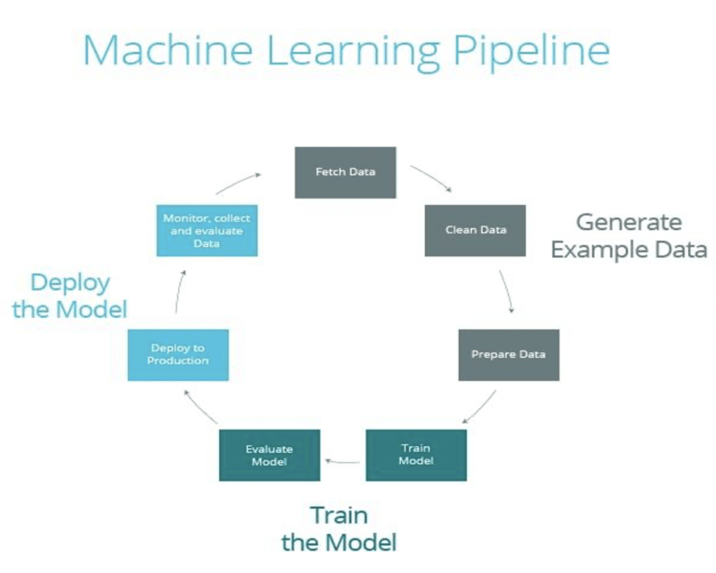
Methodology: Overview of the Pipeline
In a nutshell
Epochs and top predictions
Data preprocessing
NCF model definition with layers and embeddings.
Compiling the model with all the metrics and Adam optimizer. (Adam optimization method employed)
Extraction of top predictions’ table.
Model evaluation using different metrics and plots.
Graphing the metrics
‹#›

Slide 9
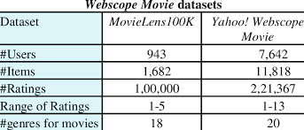
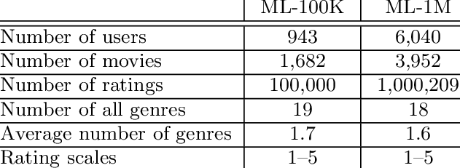
Methodology: Data Collection
1
MovieLens100K
Clean and Ready for training
2
Suitable for collaborativee filtering approaches
3

Slide 10
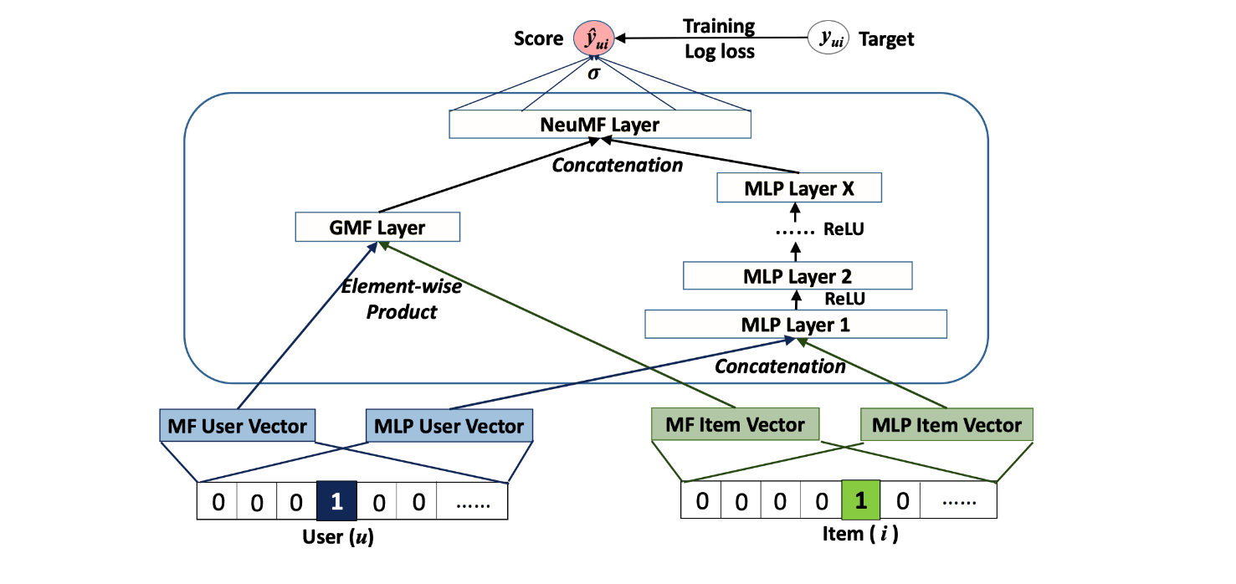
Methodology: Algorithms : Structure
Workflow
Embedding layers for users and items.
Matrix factorization (MF) and Multi-Layer Perceptron (MLP) components.
Regularization techniques used.
Configuration of dense layers and activation functions.

Slide 11
Methodology: Algorithms: Models
Lightfm
NCF using keras
employs matrix factorization to decompose the user-item interaction matrix into latent factors
Defining simple neural collaborative filtering model using keras, it combines matrix factorization and multilayer perceptron
单击此处添加文本
单击此处添加文本
Properties:
Works for both implicit and explicit feedback
uses embedding layers for users and items like other collaborative techniques
It also incorporates other additional features that might unveil certain patterns in the data
this model also supports different loss functions: logistic loss and MSE (our case)
Properties:
Embedding layers are used for both user and item features in both MF and MLP branches
The model is compiled using the binary crossentropy loss and various evaluation metrics.
convert into tenserflow dataset then train on it
uses early stopping based on validation loss
generate predictions on test set and evaluate results

Slide 12
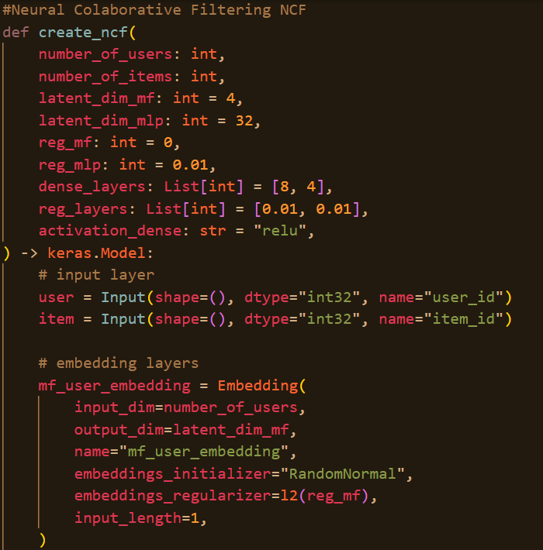
Methodology: Algorithms : A snippet from the code
How to define
NCF modele definition:
Parameters
latent dimensions mf
latent dimensions mlp
activation function, etc.
Embeddings
user matrix factorization
item matrix factorization
user MLP
item MLP

Slide 13
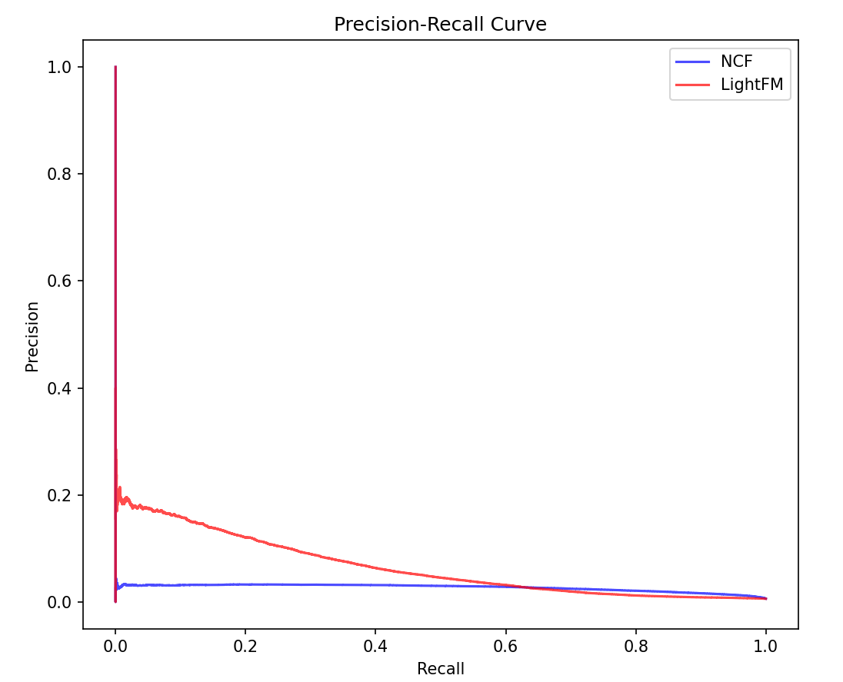
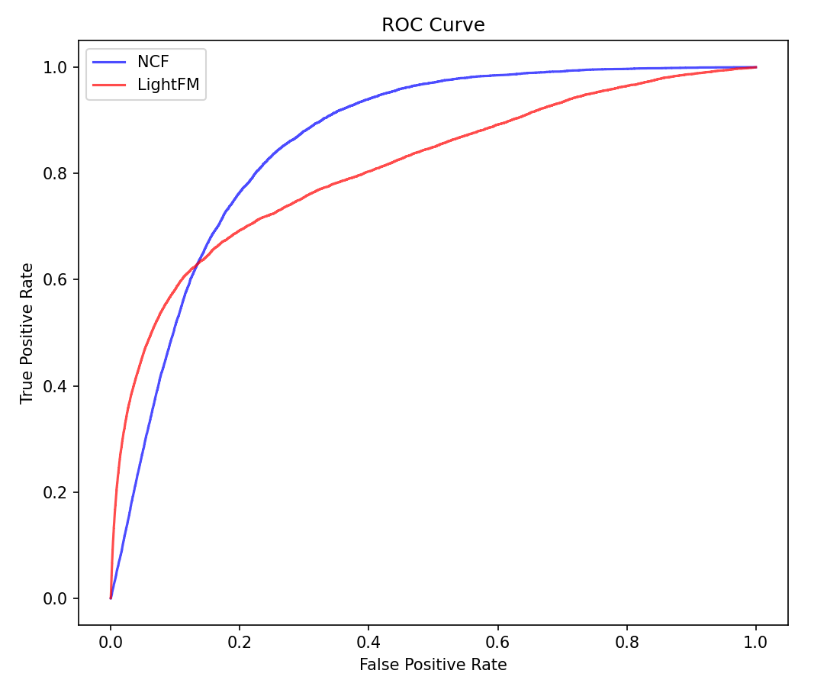
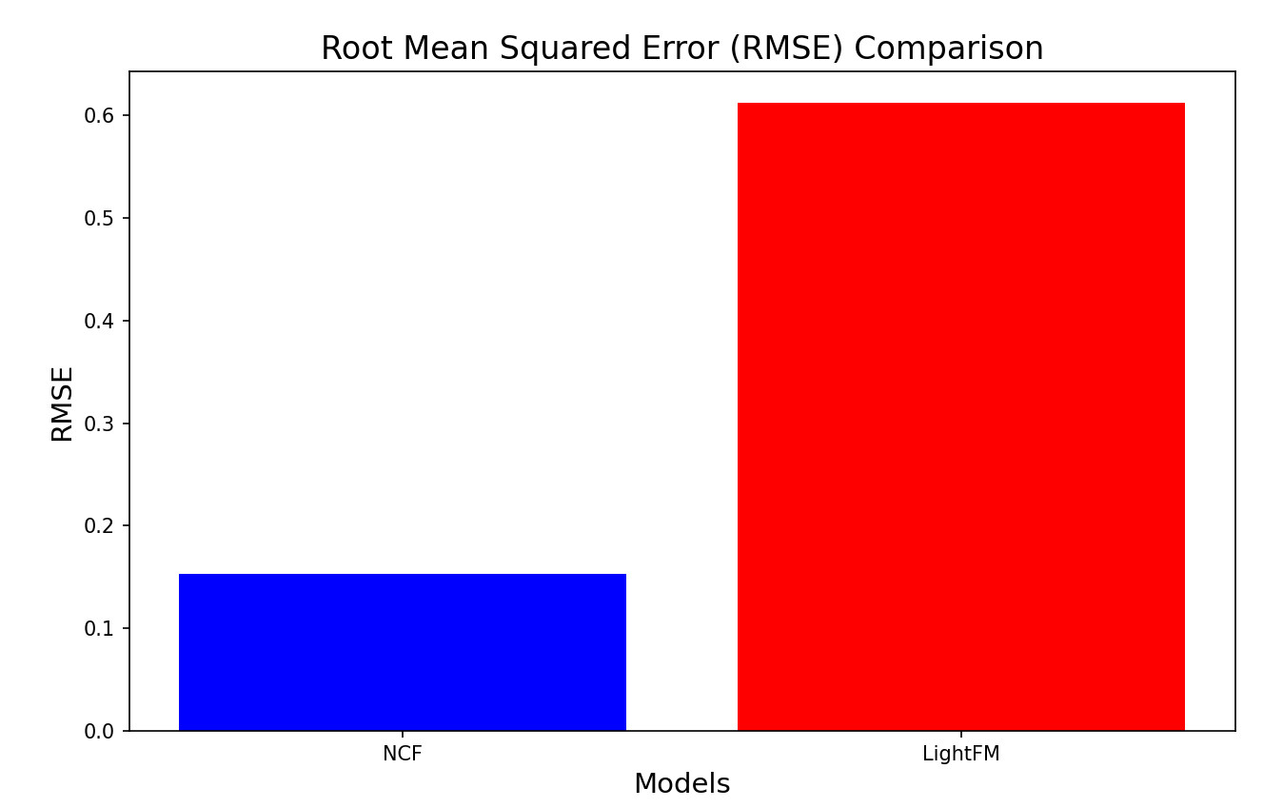
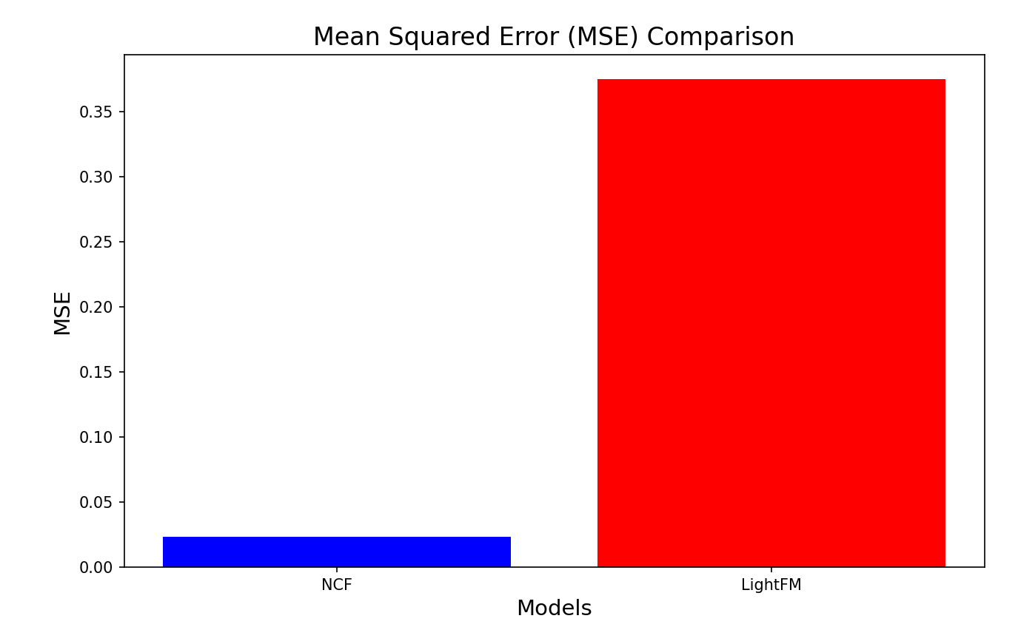
Methodology: Algorithms : Evaluation metrics
Measurements
AUC-ROC
F1 score
Accuracy
Recall at K
Precision at K
Evaluation done on both, and graphed as a comparison.

Slide 14
04 Results and Conclusion
‹#›

Slide 15
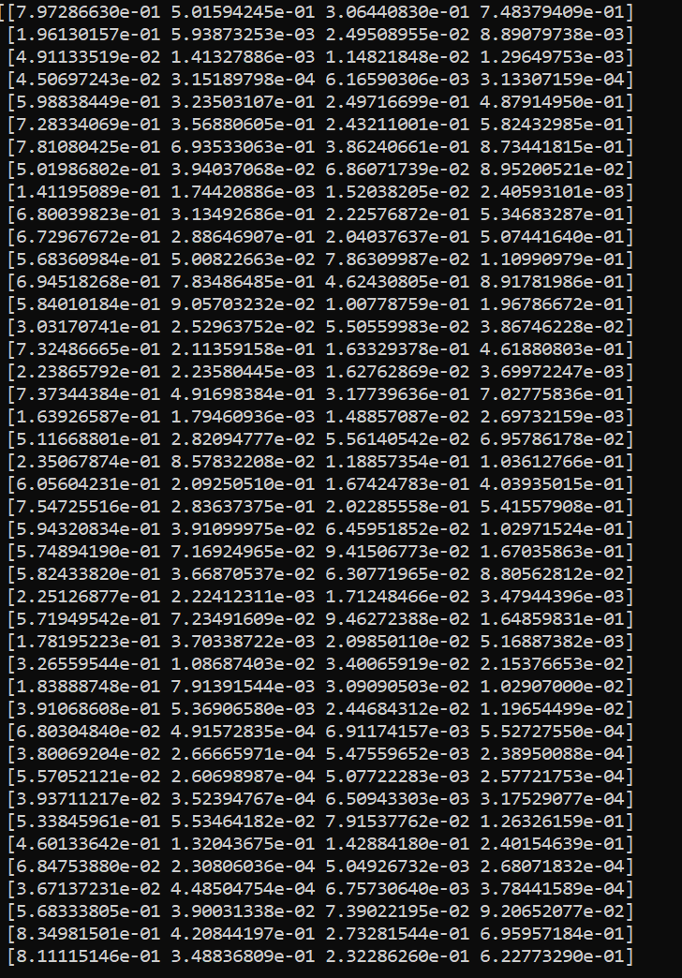
Results and Conclusion
Results
Top k = 100 predictions
64% accuracy
50% recall
table on the left shows the top 100 recommendations
Overall, my model manages to captures all the latent dimensions and provide somewhat useful recommendations

Slide 16

Limitations
04
03
time and fake reviews
02
Bias towards popular items
01
Introducing new items to the users
Giving recommendations for new users

Slide 17
谢谢

